Slide 1


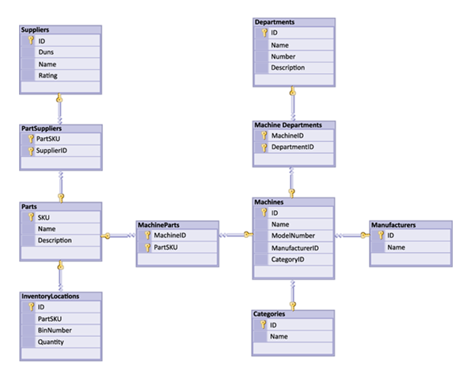


Основни познания за заявките. Въведение в MySQL
Бази от данни
Учителски екип
Обучение за ИТ кариера
https://it-kariera.mon.bg/e-learning/

Slide 2




Съдържание
Основни познания за заявките
Въведение в SQL
Селекция, Проекция, Сливане

Slide 3
Какво е SQL?
Structured Query Language (SQL) – en.wikipedia.org/wiki/SQL
Декларативен език а работа с релационни данни
Предназначен да бъде възможно по-близо до обичaйния английски език
Поддържа определяне, манипулация и контрол на достъп до записи

Slide 4
SQL – малко примери
SELECT first_name, last_name, job_title FROM employees;
SELECT * FROM projects WHERE start_date='2003-06-01';
INSERT INTO projects(name, start_date)
VALUES('Introduction to SQL Course', '2006-01-01');
UPDATE projects
SET end_date = '2006-08-31'
WHERE start_date = '2006-01-01';
DELETE FROM projects
WHERE start_date = '2006-01-01';

Slide 5
Възможности на SQL SELECT
Проекция
Връща подмножество от колони
Селекция
Връща подмнжество от редове
Сливане
Комбинира таблици по някоя колона
Таблица 1
Таблиза 2
Notes:
Capabilities of SQL SELECT Statements
A SELECT statement retrieves information from the database. Using a SELECT statement, you can do the following:
Projection: You can use the projection capability in SQL to choose the columns in a table that you want returned by your query. You can choose as few or as many columns of the table as you require.
Selection: You can use the selection capability in SQL to choose the rows in a table that you want returned by a query. You can use various criteria to restrict the rows that you see.
Joining: You can use the join capability in SQL to bring together data that is stored in different tables by creating a link between them. You learn more about joins in a later lesson.

Slide 6
SELECT – Пример
Избиране на всички колони от таблицата "departments"
Избиране на определени колони
SELECT * FROM departments;
department_id | name | manager_id
1 | Engineering | 12
2 | Tool design | 4
3 | Sales | 273
… | … | …
Списък от колони
(* за всички)
Име на таблицата
department_id | name
1 | Engineering
2 | Tool design
3 | Sales
… | …
SELECT department_id, name
FROM departments
Notes:
Selecting All Columns of All Rows
You can display all columns of data in a table by following the SELECT keyword with an asterisk (*). In the example on the slide, the department table contains five columns: DepartmentID, Name, GroupName, ModifiedDate and rowguid. The table contains 16 rows, one for each department.
You can also display all columns in the table by listing all the columns after the SELECT keyword. For example, the following SQL statement, like the example on the slide, displays all columns and all rows of the Departments table:
SELECT DepartmentID, Name, GroupName, ModifiedDate, rowguid
FROM department;
Selecting Specific Columns of All Rows
You can use the SELECT statement to display specific columns of the table by specifying the column names, separated by commas. The example on the slide displays all the department numbers and location numbers from the Departments table.
In the SELECT clause, specify the columns that you want, in the order in which you want them to appear in the output. For example, to display location before department number going from left to right, you use the following statement:
SELECT DepartmentID, Name
FROM Departments

Slide 7
SELECT – Пример(2)
Избиране на всички колони от таблицата "departments"
SELECT * FROM departments
WHERE department_id <=2
Извежда първите 2 реда от таблицата
department_id | name | manager_id
1 | Engineering | 12
2 | Tool design | 4
Notes:
Selecting All Columns of All Rows
You can display all columns of data in a table by following the SELECT keyword with an asterisk (*). In the example on the slide, the department table contains five columns: DepartmentID, Name, GroupName, ModifiedDate and rowguid. The table contains 16 rows, one for each department.
You can also display all columns in the table by listing all the columns after the SELECT keyword. For example, the following SQL statement, like the example on the slide, displays all columns and all rows of the Departments table:
SELECT DepartmentID, Name, GroupName, ModifiedDate, rowguid
FROM department;
Selecting Specific Columns of All Rows
You can use the SELECT statement to display specific columns of the table by specifying the column names, separated by commas. The example on the slide displays all the department numbers and location numbers from the Departments table.
In the SELECT clause, specify the columns that you want, in the order in which you want them to appear in the output. For example, to display location before department number going from left to right, you use the following statement:
SELECT DepartmentID, Name
FROM Departments

Slide 8


Обобщение
SQL е езикът на MySQL Server
Заявки предоставят гъвкав и мощен метод за манипулиране на записи
Основните видове SELECT са:
Проекция, селекция, сливане
SELECT *
FROM `projects`
WHERE `start_date` = '2006-01-01';

Slide 9
Основни познания за заявките. Въведение в MySQL
https://it-kariera.mon.bg/e-learning/

Slide 10




Министерство на образованието и науката (МОН)
Настоящият курс (презентации, примери, задачи, упражнения и др.) е разработен за нуждите на Национална програма "Обучение за ИТ кариера" на МОН за подготовка по професия "Приложен програмист"
Курсът е базиран на учебно съдържание и методика, предоставени от фондация "Софтуерен университет" и се разпространява под свободен лиценз CC-BY-NC-SA

